Slide 1
Comp 20140: Introduction to Project Management and Leadership
Tuesdays @ 5 & Thursday @ 5
Science Centre East E2.16
Prof. Joe Carthy
principal.science@ucd.ie
Teaching Assistant
Meadhbh O'Connor
meadhbhoconnor@gmail.com
Notes at
http://csimoodle.ucd.ie/moodle
Password: ipm

Slide 2
Course Outline
Time Management
  Managing Yourself
    Time Usage (Management)
    Aligning important things with where time is spent
    Lists: actions and contexts
  Motivation
  Setting Goals
Comp 20140: Introduction to Project Management and Leadership- Joe Carthy

Slide 3
Course Outline
Leadership
  Covey’s 7 habits
  80/20 rule (Pareto principle)
  Decision Making - WRAP process
  Managing People
  Delegation
  Leadership and conversation
  Evaluation
  Difficult people
  No Asshole Rule
  Principled negotiation
Comp 20140: Introduction to Project Management and Leadership- Joe Carthy

Slide 4
Course Outline
Leadership
  Managing People
  Delegation
  Leadership and conversation
  Evaluation
  Difficult people
  No Asshole Rule
  Principled negotiation
Comp 20140: Introduction to Project Management and Leadership- Joe Carthy

Slide 5
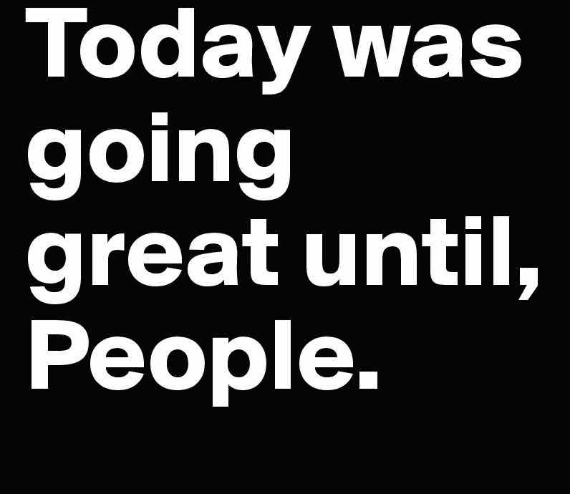
Comp 20140: Introduction to Project Management and Leadership- Joe Carthy

Slide 6
Course Outline
Project Management
  O’Connell’s Silver Bullet text
  10 steps to managing a project
  Peter’s dilemmas – PM case studies in lectures
Comp 20140: Introduction to Project Management and Leadership- Joe Carthy

Slide 7
Assessment
End of Semester Written Examination: 40%
Continuous Assessment: 60%
  Review of text from General Reading category: 10%
  Course Learning Journal: 20%
    Notes Journal of personal key learning points
  Group Project: 30%
    Development of project plan from a case study of a real or hypothetical proposed project
    MS Project (or equivalent) MUST be used to produce Project Schedule etc.
    Must pass basic MS Project test
    4 minute video on the project
    Confidential personal report – 15%
Lecture attendance is COMPULSORY
Comp 20140: Introduction to Project Management and Leadership- Joe Carthy

Slide 8
What is the most important project management skill?
Example: You have been asked to project management the construction of a first home for a couple from design to completion of build.
What is one of the most important skills you will need and use?
Comp 20140: Introduction to Project Management and Leadership- Joe Carthy

Slide 9
Some valuable skills
Organize
Plan
Negotiate
Design
Imagine
Budget
Communicate
  Talk in understandable language
  Listen
Comp 20140: Introduction to Project Management and Leadership- Joe Carthy

Slide 10
Vital to be able to LISTEN
Different ways to listen e.g.
  Listen with view to respond
  Listen to understand the other
The difference between the two is huge
PM must understand the needs and desires of the client
Comp 20140: Introduction to Project Management and Leadership- Joe Carthy

Slide 11
PM is someone who delivers dreams!
For the PM it may be another project – a job to be delivered on time, within budget and to a required quality
For the client it may be their dream e.g their 1st home, 1st newsletter, 1st novel, 1st new product …
As a PM, tread softly as you tread on clients dreams !
Therefore you must understand the dream which means focused listening
Comp 20140: Introduction to Project Management and Leadership- Joe Carthy

Slide 12
If you deliver on a dream…
Client will be your ally in recommending you fro future projects
Conversely, if you don’t deliver …
  Need to take damage limitation actions
  Apologise
  Explain
    No surprise rule
Comp 20140: Introduction to Project Management and Leadership- Joe Carthy

Slide 13
Lets get started!
“Are you Rude ?” test
Would you take a spoon of a stranger’s soup at a meal ?
  Most people would never do such a thing !
  They would consider it to be very rude and unacceptable behaviour.
Comp 20140: Introduction to Project Management and Leadership- Joe Carthy

Slide 14
Lets get started!
Have you ever interrupted someone midway in a conversation ?
to tell a funnier joke
to describe a more serious example
to provide a more pressing piece of news
to give a better idea
You have just taken a huge spoon of their soup !!
You have told them that
they are not as important as you
your idea is better and their idea is worthless
You have devalued them and perhaps damaged their self-worth
Comp 20140: Introduction to Project Management and Leadership- Joe Carthy

Slide 15
Lets get started!
Listening, actively listening is one of the most important things that a leader, PM or indeed anyone can do.
It shows respect to your colleague(s)
We will come back to it in this module BUT in all of the group discussions in lectures – our golden rule is “Do not interrupt”
Exception: chairperson is allowed when and time has run out
Comp 20140: Introduction to Project Management and Leadership- Joe Carthy

Slide 16
  Project 1: Interview for your dream job with Acme in Paris
  You have an interview in Paris for your dream job.The interview is just a week away on the following Monday afternoon and Tuesday morning.
  On the Monday afternoon, you are to arrive at Acme Paris HQ at 4 pm for afternoon meet and greet followed by a meal with management and other interviewees.
  You have a one hour interview at 11 am on Tuesday at which you must deliver a 15 minute presentation on your strengths and weaknesses and why you are the person for this job.
  Acme will pay your flights and hotel costs (up to 3 nights) which is about 2 hours from Paris CDG airport from the time you collect your baggage.
  The hotel 1 hour from Acme HQ by Metro.
  There is one complication – one of your best friends has a significant birthday party on the Sunday evening, which you had planned to attend.
Comp 20140: Introduction to Project Management and Leadership- Joe Carthy

Slide 17
  Project 1: Interview for your dream job with Acme in Paris
You have a choice of flights:
Flights to Paris
Depart Sunday morning, afternoon, evening or
Depart Monday arriving in CDG at 9 am, 10 am, 11am, 12 am, 1 am
Return flights to Dublin
Tuesday: 2 pm, 3 pm , 4 pm, 5 pm and 7.00 pm
Wednesday morning from 9 am to 1 pm
Part 1
Working backwards from the interview, make a list of all of the tasks that you must do and when they must be done by in as much detail as possible such as booking flights, what time you will leave home to catch the flight, what to do when you arrive in Paris, right up to coming home.
Part 2
You should also make a separate Travel List of all of the things you need for the trip
Comp 20140: Introduction to Project Management and Leadership- Joe Carthy

Slide 18
If anything can go wrong, it will ! Murphy’s Law
What do you do if any of the following happens:
1. You sleep out on your departure day and get up 2 hours later than you planned for. Will you still get your flight ? If not what do you do ?
2. The taxi you booked does not show up and you lose 1 hour sorting it out.
3. You drive to the airport but your car gets a puncture or runs out of fuel – you lose one hour
4. Your flight is delayed by 2 hours – does this matter ?
5. Your baggage does not arrive - 2 hours in the airport to find this out.
6. At the evening meal, red wine is spilled all over your shirt/suit/dress
7. Your hotel wake up call does not wake you and you get up at 10.30 but it will take at least 1 hour to reach Acme HQ.
8. You take the metro to the interview but get on the wrong line and you may be late.
Comp 20140: Introduction to Project Management and Leadership- Joe Carthy

Slide 19
9. Your laptop is not compatible with the projector for your presentation and your USB key copy will not load. There is no network connectivity to download your copy from the cloud.
10. Your interview is delayed and will not start until 2.30 – does this affect your return flight.
11. Your interview goes very well and they ask to meet you at 5 pm for a second two-hour session but you have booked the 5 pm flight.
Did you include sessions to practice your presentation in terms of content and timing? Did you allow enough time to change it.
Did you organise a professional interview preparation session? Yes it will cost you some money, but this is for your dream job – how do you value investing in your future? Even if you don’t get the job, the session will be useful for future interviews and to improve your communication skills.
Did you go to your friend’s party? If yes, would it be worth the risk in event of some of the above issues arising?
Comp 20140: Introduction to Project Management and Leadership- Joe Carthy

Slide 20
Lessons
Preparation is key
You need to prepare in advance
– what do you need to bring with you
– when do you need to leave your home
– when do you need to leave your hotel to get to Acme
– when do you need to return home
The travel list you use can be used for future trips, so keep a soft copy and edit it for each of your trips. Take a printed copy with you, so that when packing to come home, you can check to make sure you have packed all of your things. How many people leave their mobile phone charger behind in hotels.
Allow for contingencies
One of the key steps in project management is to allow for contingencies. Things always go wrong – tasks may take longer to do, cost more, cancellations may happen, staff get sick and so on.
Comp 20140: Introduction to Project Management and Leadership- Joe Carthy

Slide 21
Many of the issues that arise on this project are solved by allowing yourself extra time. By flying out on the Sunday and back on the Wednesday, you have built in lots of time to cope with delayed flights, lost baggage, finding the hotel, finding the interview location (visit it on the Sunday).
Building contingency time into your plan is also an excellent way to reduce your stress. This is an interview for your dream job. Your focus should be on doing the best possible interview. It can be very stressful if you find yourself turning up late or just barely on time and makes it more difficult for you to deliver of your best.
Contingency is not just about time. A spare shirt or alternative outfit is also contingency in the event of wine/food spillage!
Comp 20140: Introduction to Project Management and Leadership- Joe Carthy

Slide 22
We could think of behavioural contingency – indulging too much from the free bar at the pre-interview meal is probably best avoided in terms of making the right impression (this is part of your interview process, even if its very informal). It also means that you will have a clear head the next morning!
Your printed maps to find the hotel and the interview are also important as well as written addresses and phone numbers if you need to take a taxi. The phone number of Acme is also vital in the event that your are going to be late and you need to alert them.
This project is a classic situation where sensible use of lists can make your life a lot easier and reduce your stress.
Take away message: Plan the project and make lists your friend.
Comp 20140: Introduction to Project Management and Leadership- Joe Carthy

Slide 23
Project Management & Careers
Careers in Project Management itself
Most jobs will involve some element of project management
  You may be part of the team
  You may be the project manager for a task as part of your job
Relevance of Comp 20140 Group work
  Develop team skills
    Deal with difficult team members
  Develop leadership skills
  Develop communication skills
  Develop problem solving skills
  Develop project management skills
  Gives you examples for interview questions
Comp 20140: Introduction to Project Management and Leadership- Joe Carthy

Slide 24
Project Management & Careers
Interview Questions
  Give a specific example of your
    Team skills
    Leadership
    Dealing with a difficult person or situation
    Attention to detail
    Problem solving
Comp 20140: Introduction to Project Management and Leadership- Joe Carthy

Slide 25
Project Management & Careers
Reply might start with
  I took a module on project management and we had a group project where …
  I chaired group meetings
  I wrote significant parts of the report
  I did up the Gantt charts for the project
  I was responsible for the project budget
  I gave the Powerpoint presentation
  I reported for my group in lectures of 100+ peers
  I confronted a difficult team member in a diplomatic way …
  I gained insight into group dynamics as my group had very different types of people (introvert to extrovert, lazy to over zealous,..)
  I enjoyed the challenges !!!!!!!!
Comp 20140: Introduction to Project Management and Leadership- Joe Carthy

Slide 26
UCD Smurfit School of Business offers MSc in PM
  http://www.smurfitschool.ie/mastersprogrammes/management/mscinprojectmanagement/
Comp 20140: Introduction to Project Management and Leadership- Joe Carthy

Slide 27
What is Project Management
Process of managing projects !
  Fundamentals are straightforward and common to many disciplines
  Need to understand concept of project
  Need to understand managing in this context
Project - many definitions
  Work performed by an organisation one time to produce a unique outcome
    One time: definite start and end
    Unique: different from anything done before
    Temporary
Project Management Institute (PMI) definition:
  The application of knowledge, skills, tools and techniques to project activities to meet project requirements
  PMI is a not-for-profit association for project management professionals (PMPs) As part of its efforts to establish project management as a true profession, PMI offers a PMP certification exam and published a work entitled Guide to the Project Management Body of Knowledge,-PMBOK.
Comp 20140: Introduction to Project Management and Leadership- Joe Carthy

Slide 28
Examples of Projects
    Building a new house
    Developing a new software application
    Creating a radio advertisement
    Writing a PhD proposal
  Not the same as operations or processes - Ongoing & repetitive e.g.
    Processing customer orders
    Company helpline
    Daily manufacturing process
Comp 20140: Introduction to Project Management and Leadership- Joe Carthy

Slide 29
Which of the following are projects (from PD Gardiner)
    Building bridge
    Designing an Information System
    Planning an election campaign
    Swimming
    Making a television programme
    Doing a crossword
    Solving a problem
    Getting a job
    Writing an essay
    Working in an office
Comp 20140: Introduction to Project Management and Leadership- Joe Carthy

Slide 30
Which of the following are projects (from PD Gardiner)
    All are projects except
      Swimming
      Working in an office
    These are too general and non-specific. Could become projects:
    Swimming to win a particular race
    Creating a marketing brochure as an office task
Comp 20140: Introduction to Project Management and Leadership- Joe Carthy

Slide 31
Managing Projects
Involves applying planning, organising, implementing, leading and controlling project to meet goals of the organisation
Process of defining a project, developing a plan, executing the plan, overcoming obstacles, managing risks and taking corrective actions
Process of managing the competing demands between the desired results and the constraints (time &cost)
Process of leading a team that has not worked together before to accomplish something that has not been done before in a given time with a limited amount of money and resources
Comp 20140: Introduction to Project Management and Leadership- Joe Carthy

Slide 32
Value of Project Management
Competition between organisations is fierce
  Need to “do more with less”
Good PM is essential for organisations
  Enables better leverage of internal and external resources
  Reduces financial losses by “killing off” poor projects early
For individuals
  Provides a career path with unique & challenging opportunities on each new project
  Prepares you for organisational leadership to CxO level
  Provides career path that requires all of your abilities & knowledge
Comp 20140: Introduction to Project Management and Leadership- Joe Carthy

Slide 33
Why are projects Challenging
NEW: each project is unique - never done before
Multiple expectations
  Each project has many stakeholders, each with their own expectations for the project
Communication obstacles
  Many stakeholders
  Project team members
Balancing competing demands
  Time is limited
  Budget is limited
  Resources are limited
  Quality required
  Meet expectations
Comp 20140: Introduction to Project Management and Leadership- Joe Carthy

Slide 34
Why are projects Challenging
Cutting edge
  Often deal with new technologies - more risks/unknowns
Collaboration
  Project team may have stakeholders from different areas who have not worked together before - must learn to work together
Estimating the work is difficult
  Time & costs are built around work estimates
  Project is unique with new team
Comp 20140: Introduction to Project Management and Leadership- Joe Carthy

Slide 35
Time Management
Why Bother ?

Slide 36
What would you like to spend more time doing ?
Comp 20140: Introduction to Project Management and Leadership- Joe Carthy

Slide 37
People would like to spend more time:
Interpersonal activities
    Socialising in pub, clubs
    Attending sporting events, concerts
    Family time
    Sex
Personal time (relaxing, hobbies, reflection)
Health and Fitness
Work and Career
Comp 20140: Introduction to Project Management and Leadership- Joe Carthy

Slide 38
People would like to spend less time
Some work activities
    Dealing with difficult people
    Boring tasks
    Unrecognised contributions
    The “job”
    Housework, food shopping
Commuting
Studying “boring topics”
etc
Comp 20140: Introduction to Project Management and Leadership- Joe Carthy

Slide 39
Major Goal of time management
Allow you spend more time doing the things you want to do !
  Things that are important to you
  Things that impact on your life and relationships
Therefore you need to spend less time on the other stuff
Time Management is one skill to help you get the balance but not the only one.
Comp 20140: Introduction to Project Management and Leadership- Joe Carthy

Slide 40
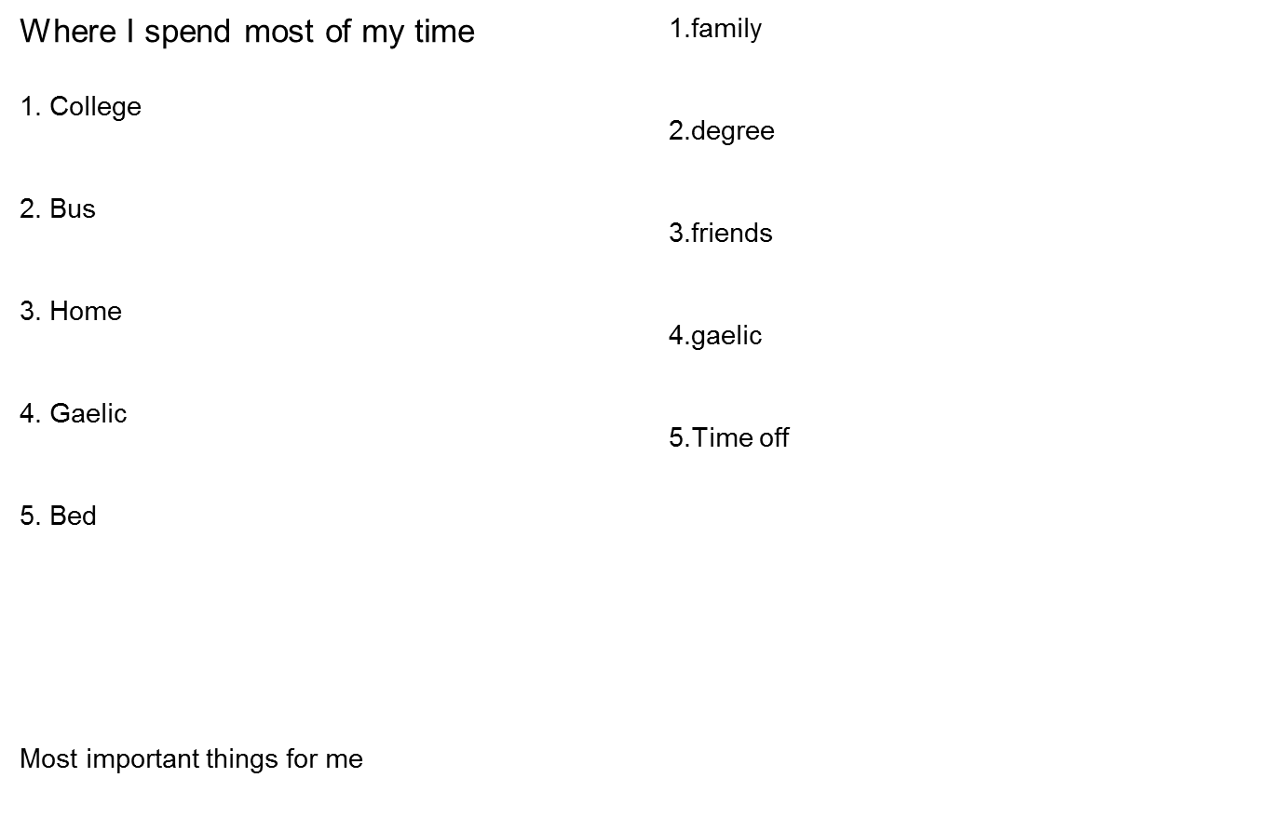
Complete the two lists below (3 mins each)
Comp 20140: Introduction to Project Management and Leadership- Joe Carthy

Slide 41
Alignments
Reflect on the two lists from the previous slide
Are they aligned – do you spend enough of your time on your important things ?
For more information see Moodle document: “The Time Management Secret to Eliminate Your Time Wasters” or the url: http://www.asianefficiency.com/goals/the-time-management-secret-that-will-eliminate-all-your-time-wasters/
Comp 20140: Introduction to Project Management and Leadership- Joe Carthy

